Slide 1
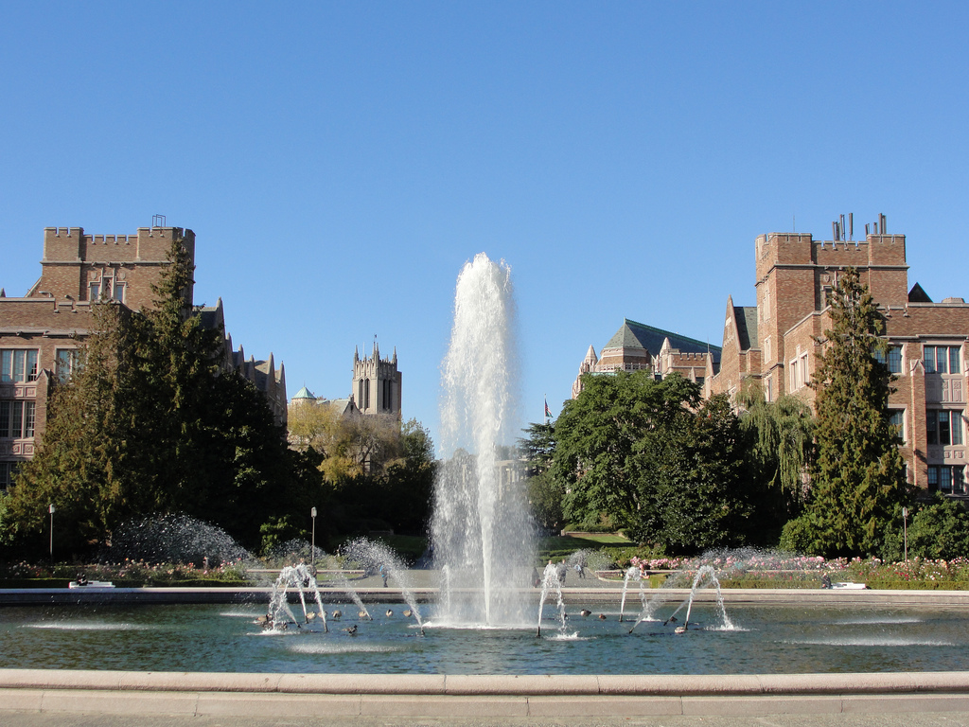
Building earthquake early warning for the west coast

Slide 2
Progress of West Coast EEW
$8.2M currently in next year’s budget
$10-12 for following year?
Misc up-front funding is building infrastructure
$5M UWASE funding for SoCal
$10M proposed from general budget by Gov. Brown
Oregon TA purchases, and more (Toomey)
$16M/yr from USGS for full implementation plan
For entire West Coast of US, 1/3 for PNW
PNW is 2/3 WA, 1/3 OR
5-10 years to finish PNW, but operative sooner
Not fully funded yet, see above.

Slide 3
Strong private support
$7M from Moore Foundation
With $600K “cost extension”
Another $3M announced at White House workshop
Additional White House announcements
$300K from Amazon – Geodetic method
$150K from Puget Sound Energy, 8 stations
Strong support from
Intel, Boeing, many others

Slide 4
PNW EEW
Very complicated, but seems on course
UW/UO/USGS split
USGS partly personnel, partly equipment
Some core jobs located in So. California
Some geodetic effort aimed at Menlo Park
Current funding by yearly 2-year proposals
Plus end-of-year redistribution of left-over funds
Station counts problematic
Which are old PNSN, which EEW, and which volcanic?
How much of an upgrade counts as a new station?
Agitating for offshore stations not simple, either.
Canada, Cal have been frictionless, so far …

Slide 5
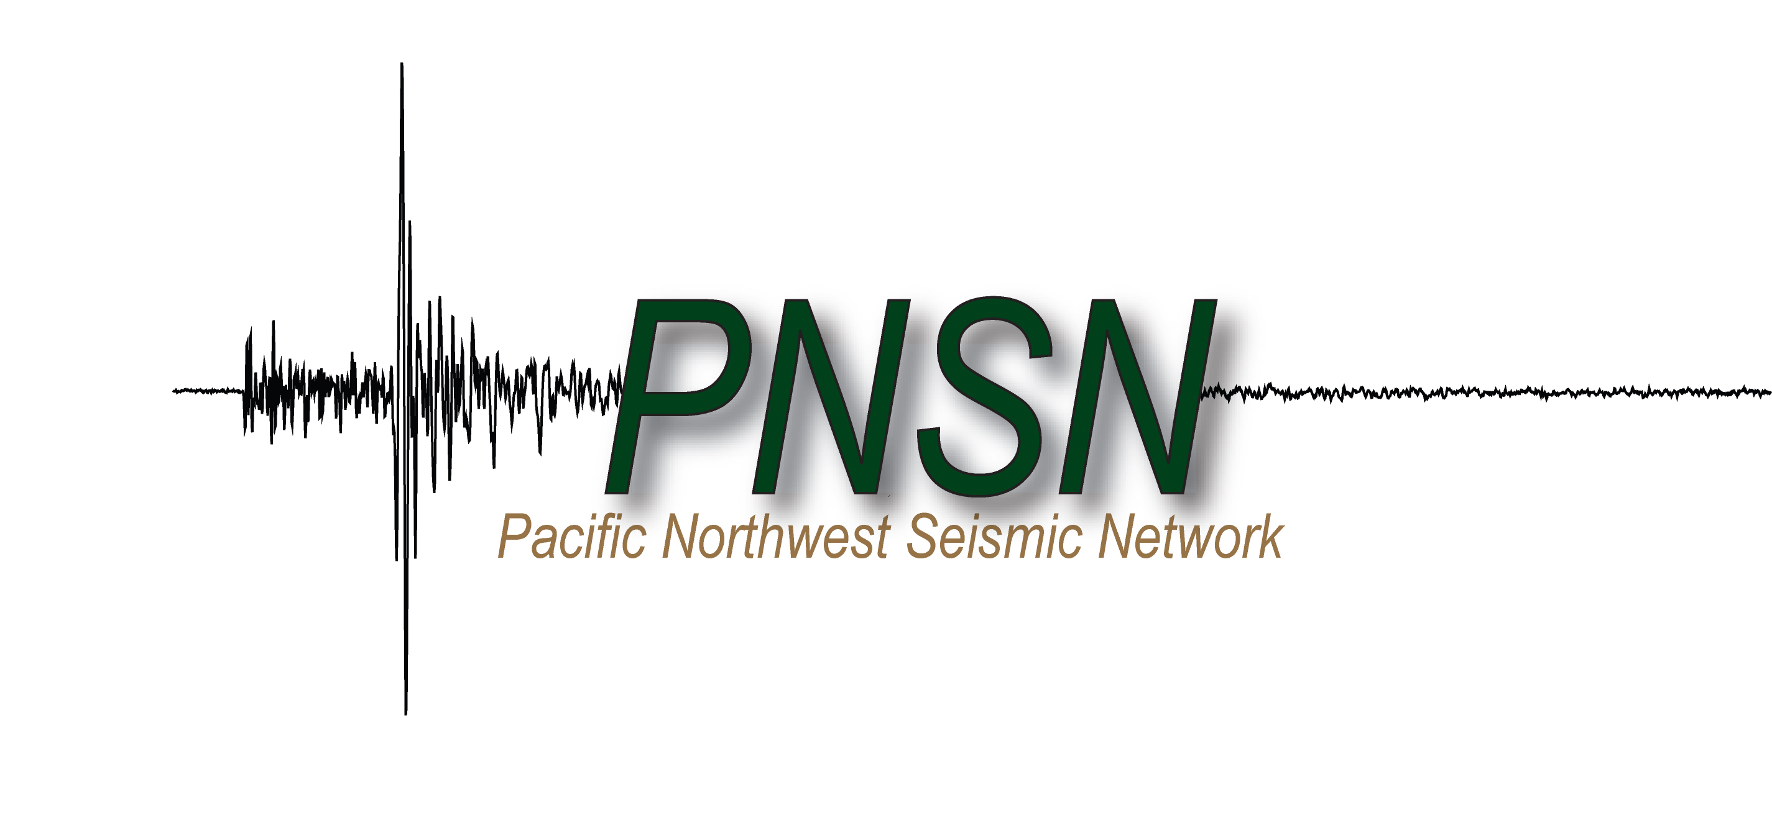
Event timeline
2-4 minutes
Md, Auto Location
~20 seconds
Crude
Location,
No Magnitude
(Nobody sees)
10 minutes
Human Review,
Sent to EIDS
Phone OES;
Team Telecon
5-6 minutes
Auto Focal
Mechanism.
ShakeMap
started. DYFI?
13-16 minutes
FPS, ShakeMap, Mw
Press interviews.
0
2
4
6
8
10
12
14
16
5-15 seconds
EQ early
warning
minutes after earthquake

Slide 6
3-fold way of EEW
1. P wave arrives faster than strong shaking
2. Stations can be closer to rupture initiation than people and property to be warned
3. Progression of earthquake can be guessed from start
Initiation seems to indicate magnitude better than many of us expected
Some earthquakes are “characteristic”

Slide 7
EEW considerations
Earthquake early warning and fast response
Slowing traffic, trains, airports,
Hospitals, jump-starting emergency operations,
Warning delicate industrial operations.
Modest expense – our plan $16M/yr.
Everybody that’s anybody is doing it:
Japan (~$1B), China (~$300M+), Mexico, Korea, Romania, Taiwan, Mongolia, … are doing it now.
It’s not hard:
Basic physics known for more than a century.
Accurate results before chaos sets in.
Much better situational awareness during chaos.

Slide 8
Benefits grow with time
Building with specialized EEW equipment.
Linking in to more sophisticated networked operations.
People will learn to take better advantage of EEW with familiarity.
Growing pressure to provide awareness faster.
Building on other emergency plans, warning protocols.

Slide 9
Last 10,000 years of M8+ earthquakes
from offshore geology – Type 1
(Goldfinger et al., 2008, Bull, Seis. Soc. Amer)
20 ~M9 events
20 ~M8 to M8.5 events

Slide 10
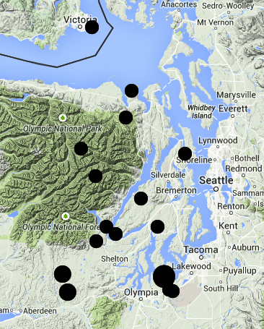
Type 2
Deep Puget Sound earthquakes
Since 1969, plus 1965 & 1949,
M > 4
Depth 40-53 km
1965
*
2001
*
1949

Slide 11
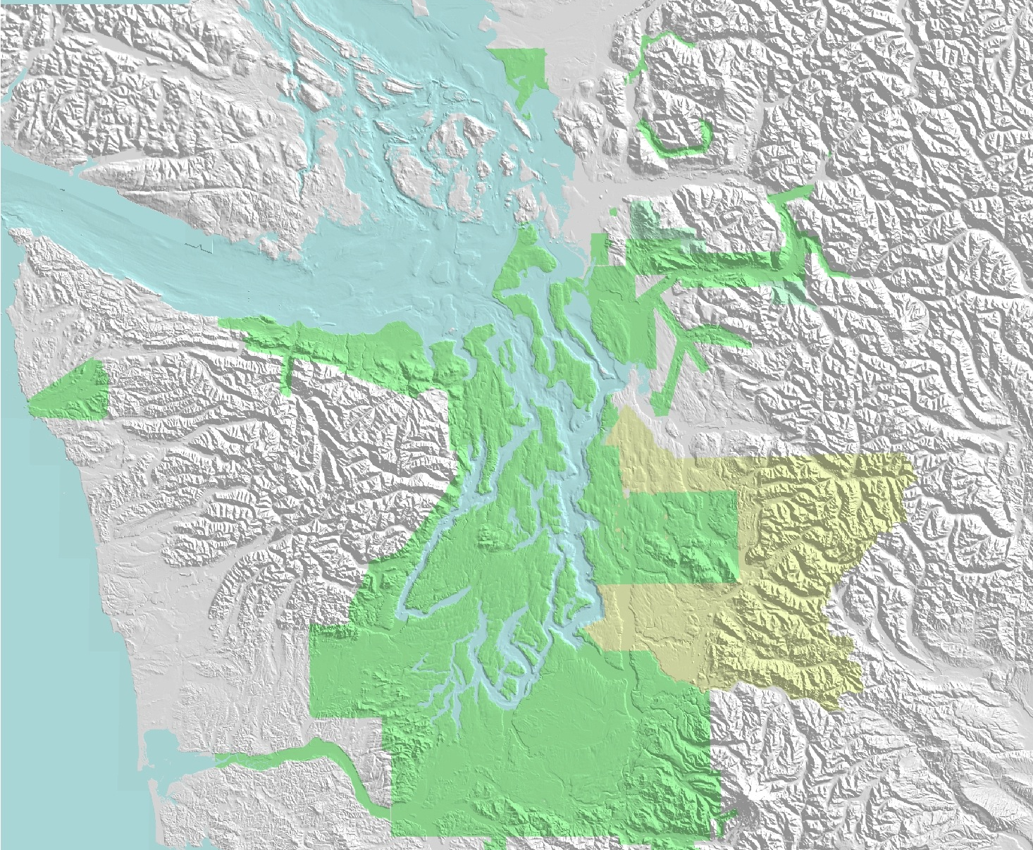
Crustal earthquakes
Type 3
Boulder Creek fault
Bellingham
Victoria
Devils Mtn FZ
Utsalady Pt
fault
?
SWIF
Little River fault
*
Cascadia megathrust
Seattle
Seattle fault
Tacoma fault
*
Olympia fault

Slide 12
Approximate 50-year probabilities
Cascadia M9: 14%
Southern Cascadia M8-9: 25-40%
Puget Sound and I-5 corridor
Shallow Seattle Fault M ≥ 6.5: 5%
Shallow M ≥ 6.5 in entire PS area: 15%
Deep M ≥ 6.5: 84%
(1949, 1965, 2001, plus smaller events)

Slide 13
Cascadian EEW Capabilities
Megathrust Earthquakes
1/2 minute to 5 minutes warning to urban centers (depending on quake starting point and location).
Can forecast chance of M7+ growing to M9.
Enhanced tsunami forecasts possible (w/ NOAA).
Deep events
10-20s easy.
Crustal faults
“Blind Zones” can limit usefulness of warnings.
Would benefit from denser/better instrumentation.

Slide 14
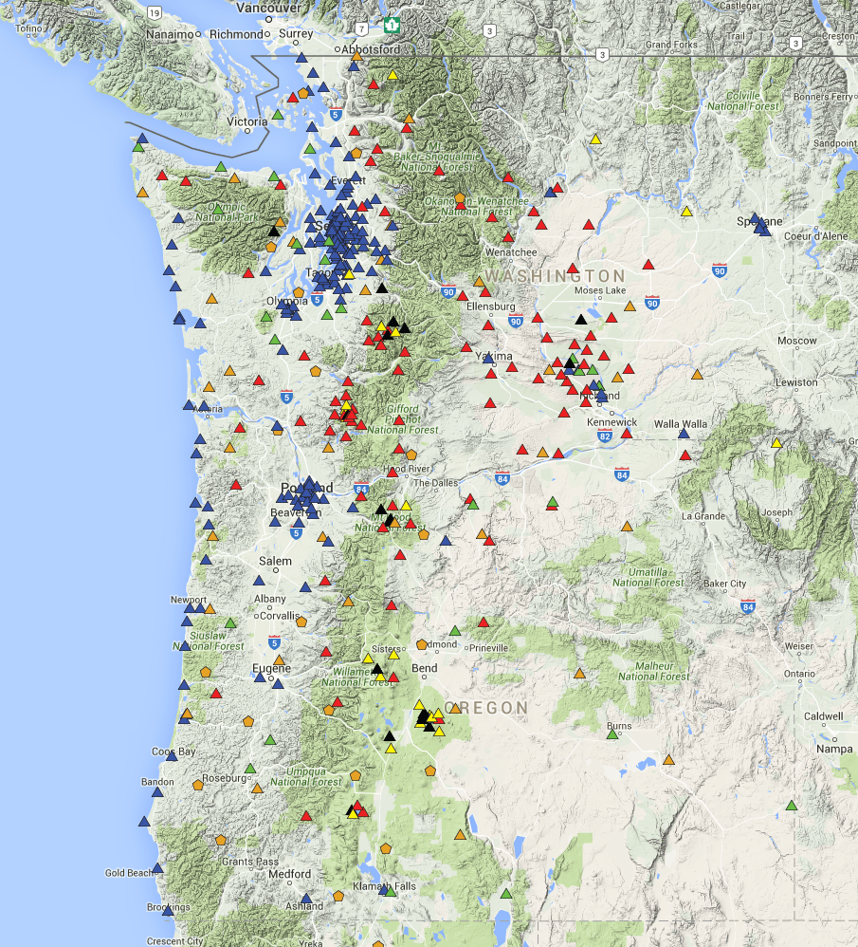
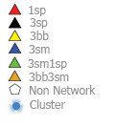
Station Status
Stations we maintain.
Notes:
In recognition of our close collaboration with CVO, I’ve added in CVO-operated stations (mostly yellow triangles on volcanoes). In the past year we’ve put out 24 new accelerographs along the coast, co-located with GPS (thanks GBMF!). This also shows NetQuakes, about which more in a moment. The Red triangles are our old style analog stations which it is becoming important to transition to digital or abandon. We simply can’t support the old technology except in rare circumstances.

Slide 15
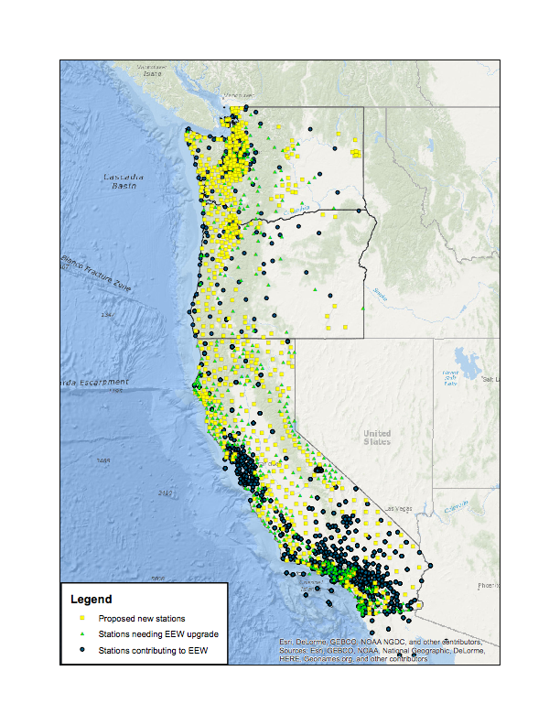
Network Future
Driven by Early Warning
Shown is the Implementation Plan level of instrumentation for ShakeAlert on the West-Coast.
Notes:
This slide illustrates the networks envisioned to power ShakeAlert. These are all digital stations that would be used. Blue dots are current contributors, green triangles are awaiting upgrades, and yellow are new stations envisioned in the Implementation Plan.

Slide 16
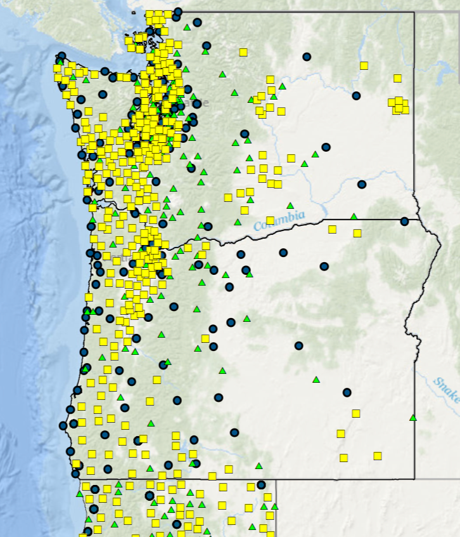
Network Future
Closeup of the PacNW
A challenge for new stations: Locating, permitting (including NEPA and landowner agreements) and long-term management.
Strategy: Outsource as much as possible.
Notes:
This slide illustrates the networks envisioned to power ShakeAlert. These are all digital stations that would be used. Blue dots are current contributors, green triangles are awaiting upgrades, and yellow are new stations envisioned in the Implementation Plan. We are starting off by having Tom try to hire sub-contractors just to do the permitting for up to 50 stations. about 300 yellow stations are shown here.

Slide 17
Little tests of EEW system
M3.5 event near Nisqually quake, 13 s warning, right magnitude
M3 off Salem/Corvallis, killed by latency
(If only)
Current reality

Slide 18
Magnitude, motions fed to ShakeMap
Initial, no strong motions
Using geology
Using site amplification factors
Later, ShakeMap is also constrained by motions (only possible behind S wavefront).
Re-evaluated every 1s

Slide 19
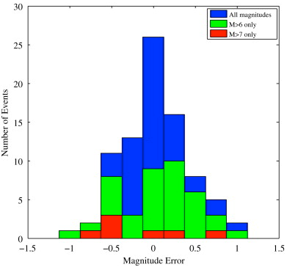
Magnitude accuracy from Japan (typical)
Brown, Allen, Hellweg, et al., Soil Dyn. and EQ Eng., 31, 2011

Slide 20
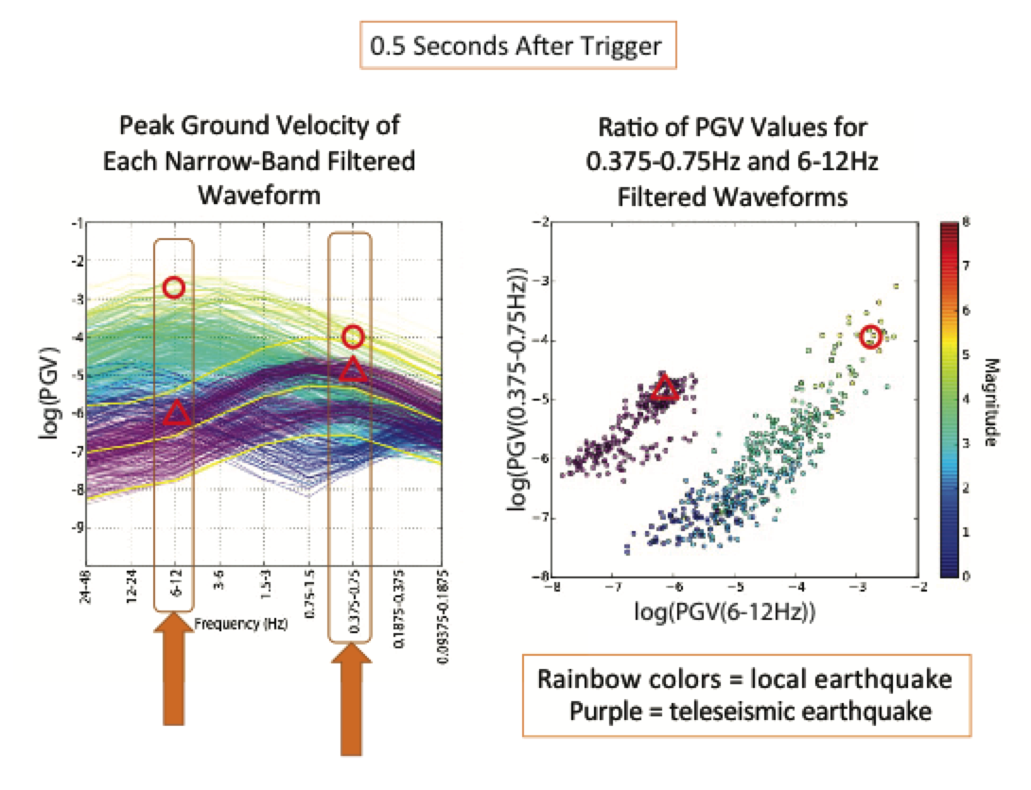
Teleseismic P wave rejection – first 0.5s of seismogram

Slide 21
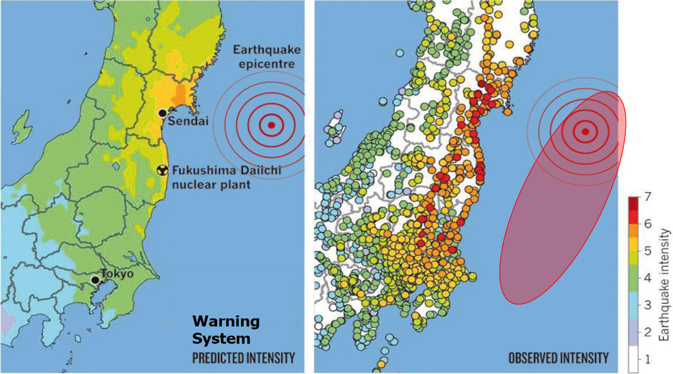
Alert
Challenge 1
CISN Shake
M. Böse
2011 M9 Tohoku-Oki earthquake (Japan)
Point source
~400 km
Finite Fault
No warning!
Predicted by JMA early warning system
Observed

Slide 22
3 more geodetic methods
2 more seismic methods
VS, onsite
FinDer – (really seismic) estimates faulting area from spatial extend of strong S (and P) waves.
G-Fast – get magnitude from peak GPS displacement (S wave, slower but goes up to M9).
Befores, Glarms, others – estimate fault slip distribution across fault plane (from GPS static offset, even slower, just useful for zipper arrays or tsunami warning).

Slide 23
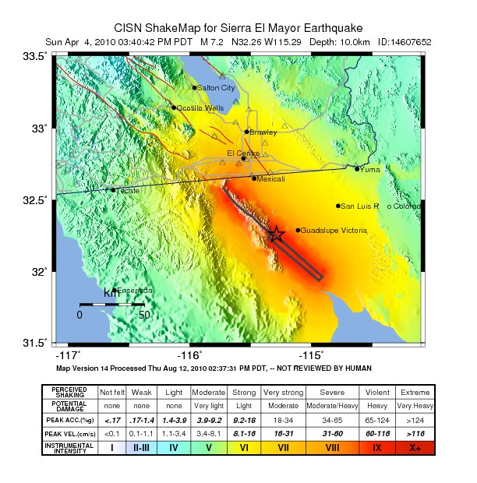
Alert
Challenge 2
CISN Shake
M. Böse
2010 M7.2 El Mayor Cucapah earthquake (Baja)
P
S
P
S
M6.3
M7.2
El Mayor
P
S
common earthquake

Slide 24
Alert
Challenge 3
CISN Shake
M. Böse
2010 M7.2 El Mayor Cucapah earthquake (Baja)
10 minutes
hundreds to thousands of aftershocks!

Slide 25
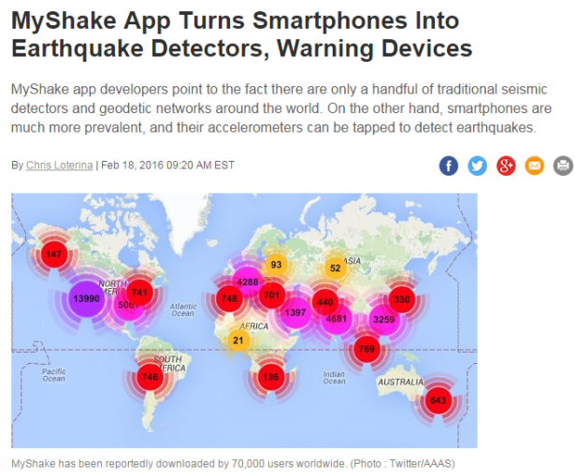

Slide 26
Diego Melgar

Slide 27
PNW ShakeAlert Testers
Last Feb – distributed alarms to a list of test users.
Groups with dedicated emergency managers
Imminently – G-FAST added to warnings
In the fall, PNSN test users can run internal EEW projects, as CISN has allowed since this past Feb.
Then see how funding evolves
Aiming for public warnings ASAP, within 1 year?
Current software runs on hardwired computers
Limits use to general audience
Several smartphone apps are being tested
24/7 notifications much easier

Slide 28
PNW ShakeAlert Testers
Private Sector:
Alaska Airlines
The Boeing Company
Intel Corporation
Microsoft
PACCAR Inc
British Petroleum
Puget Sound Energy
Beta Tester for OSH
Providence Health & Services
Local Government:
Portland Bureau of Emergency Management
City of Seattle Office of Emergency Management
Seattle Public Utilities (Water, Sewer, Garbage, Networks)
Seattle City Light
Port of Seattle
Sound Transit
State and Provincial Government
Emergency Management of British Columbia
Oregon Dept. Of Geology And Mineral Industries
Oregon Department of Transportation
Univ. of Washington Emergency Management
Washington Dept of Natural Resources / Geology
Washington State Dept Of Transportation
Federal Government:
Bonneville Power Administration
FEMA Region X
Ocean Networks Canada
Natural Resources Canada
NOAA/PMEL
Naval Air Station Whidbey Island
USGS
NGOs:
North West Healthcare Response Network
Our research partners:
Hawaiian Volcano Observatory
Central Washington University
Caltech
University of Oregon
Berkeley Seismology Laboratory
USGS
Early Warning Labs

Slide 29
Areas also expressing interest
Canada
Alaska
Nevada
4. Hawaii
Utah
Eastern Canada
...

Slide 30
Practical issues
Education of public
Not 100% solution – blind zone, foreshocks …
Long-term nature of benefits
Pranksters and saboteurs tricky to forestall
Co-ordination with private industry
“free”, but partial
Some willing to make outrageous claims
Complicate process in California
Collaboration will actually be beneficial

Slide 31
Action items?
Keeping RAC informed – quarterly reports
Recommendations for
EEW build up and roll-out
Seattle retrofit effort
volcanoes vs earthquakes
changes in Oregon (Doug Toomey)
offshore efforts
Other efforts of which we’ve lost track?

