Slide 1

June 7-10, 2016 Emergency Operations and Coordination Centers (EOC/ECCs) at all levels of government and the private sector will activate to conduct a simulated field response operation within their jurisdictions and with neighboring communities, state EOCs, FEMA, and major military commands.
See https://www.fema.gov/cascadia-rising-2016

Slide 2
Exercise scenario built on info gathered & compiled by the PNSN.
“The narrative for this Cascadia Rising exercise relies upon the 90th percentile damage – the damage state with only a 10 percent estimated chance of being exceeded. By using a worst case scenario model, …
The number of deaths could exceed 10,000, and more than 30,000 people could be injured. The economic impacts could also be significant. For Washington and Oregon, the direct economic losses have been estimated at upward of $81 billion.”

Slide 3
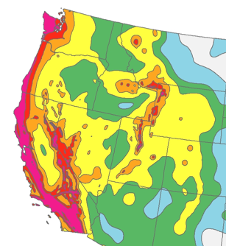
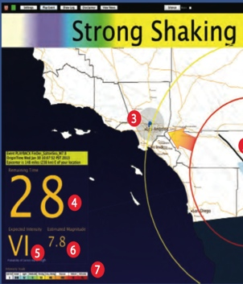
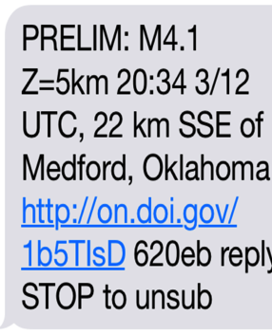

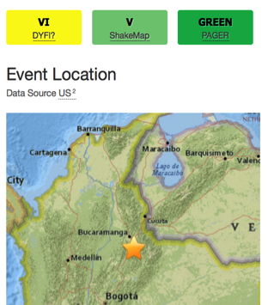
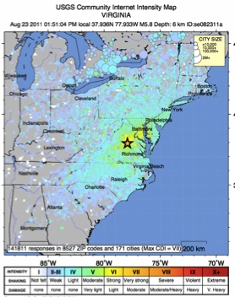
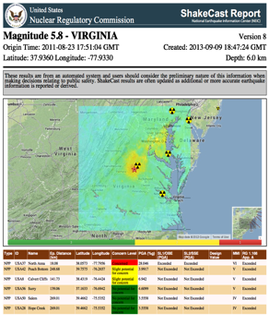

Opportunity for E&O: Webinars & Seminars, featuring PNSN
Realtime Earthquake Products
Years->hours
before
During
After
  PSHA
  (Probabilistic Seismic Hazard Assessments)
  PAGER (Prompt Assessment of Global Earthquakes for Response)
  EEW
  (Earthquake Early Warning)
  Earthquake
  Notification
  Service
  ShakeMap
  0.0 Sec
  3 Minutes
  10 Minutes
  TED
  Web
  DYFI?
  ShakeCast
http://earthquake.usgs.gov
Notes:
Earthquake Information System. (EIS)
Holistic view of earthquake information systems.
What’s Next? Should be comprised of a combination of Aftershock probabilities &NEIC Tectonic summaries. GNS New Zealand his done this well (Gerstenberger’s lead).
For any event, not all products are either guaranteed, nor are they of equal importance or robustness. Some events (outside of CA will not have EEW; ShakeMap is less robust where fewer stations are available; OEF will be there for all aftershocks, but may not be useful for all mainshock (e.g., no foreshocks occurred before Napa event)
Expectations are that the system works no matter what the event, but not all products are required for a successful response.

Slide 4
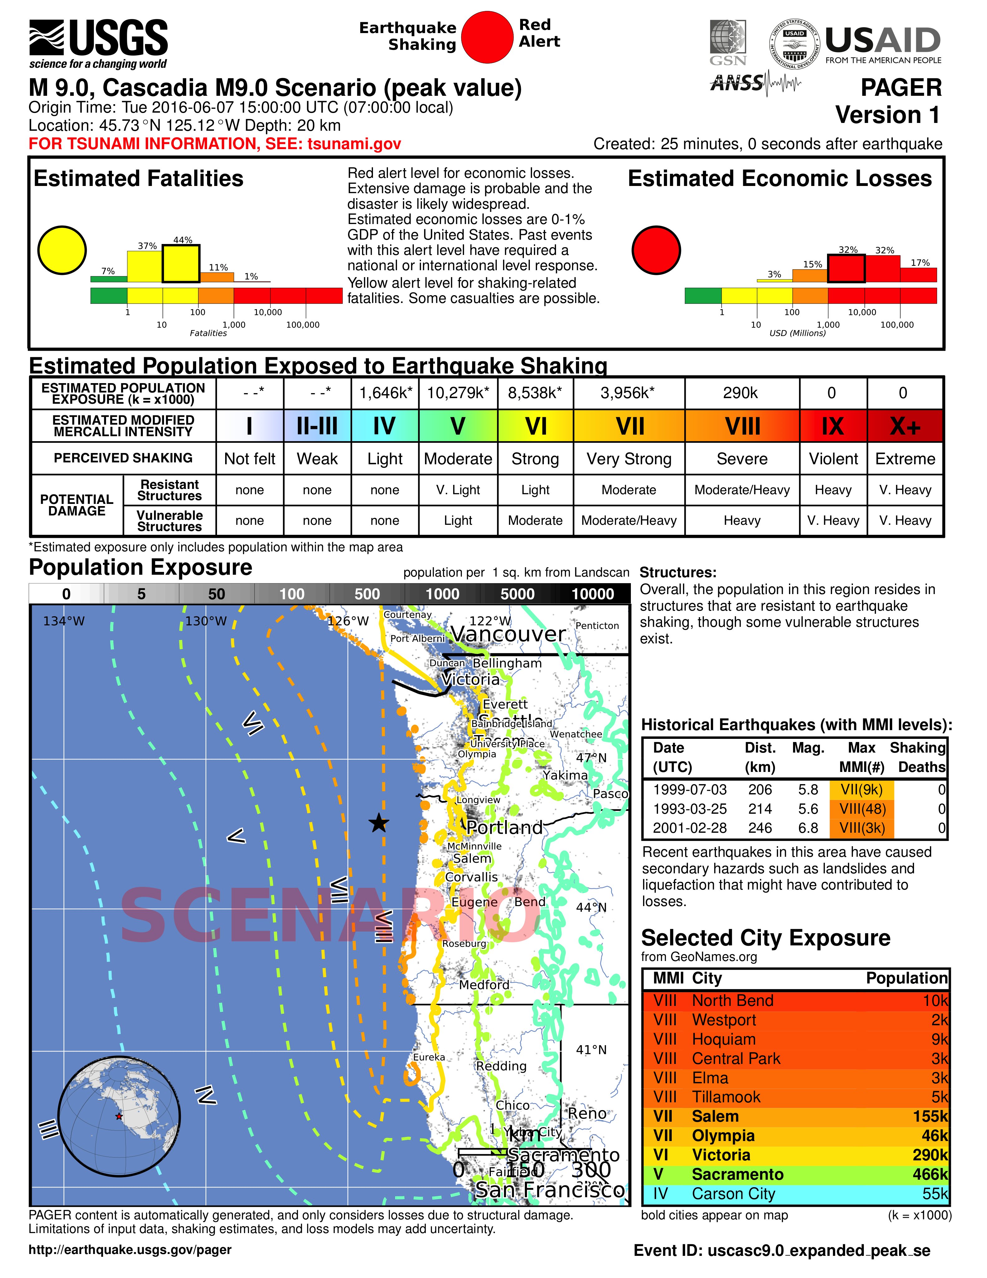
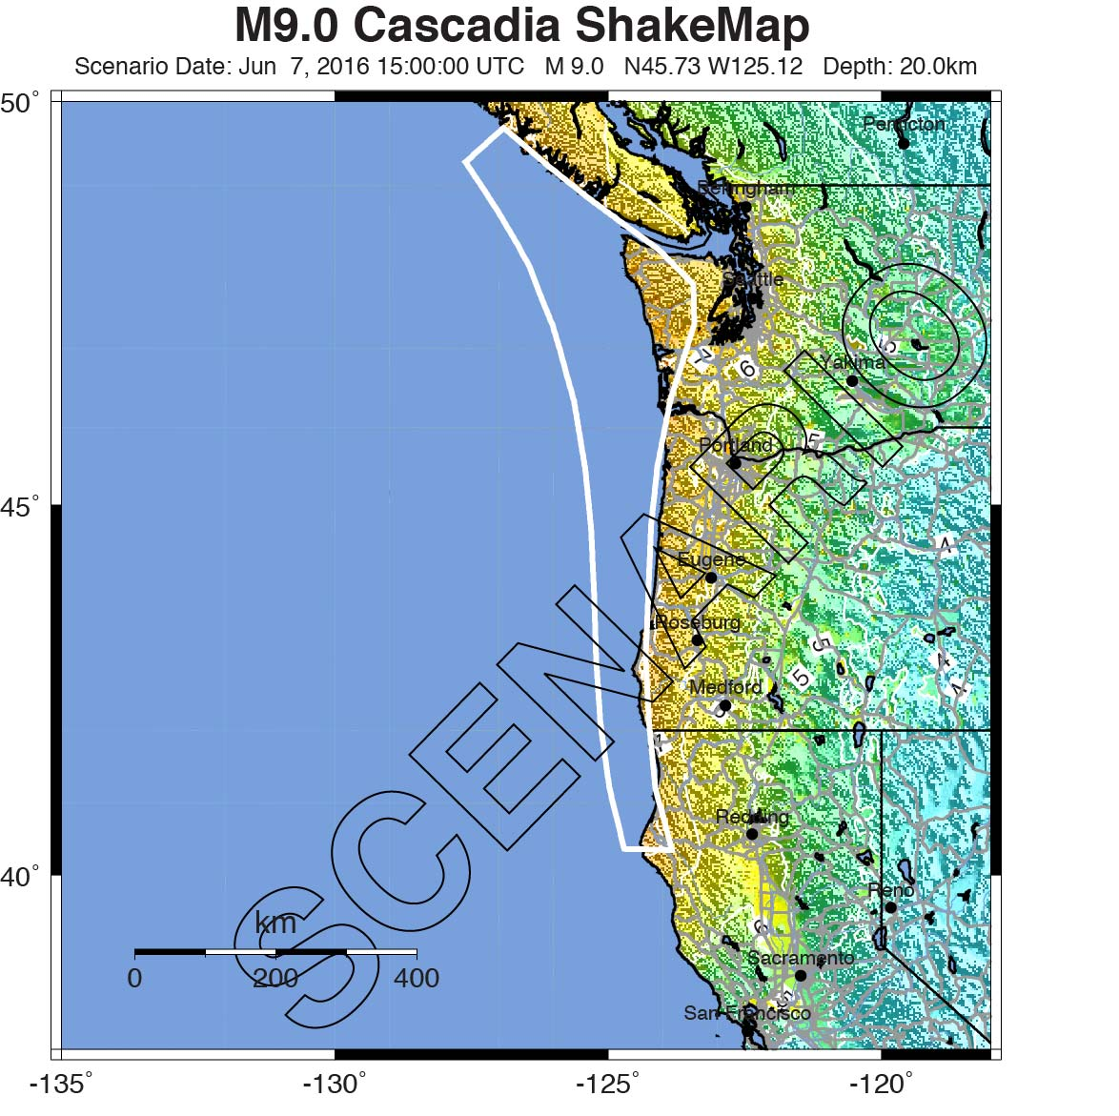
Situational awareness products provided

Slide 5
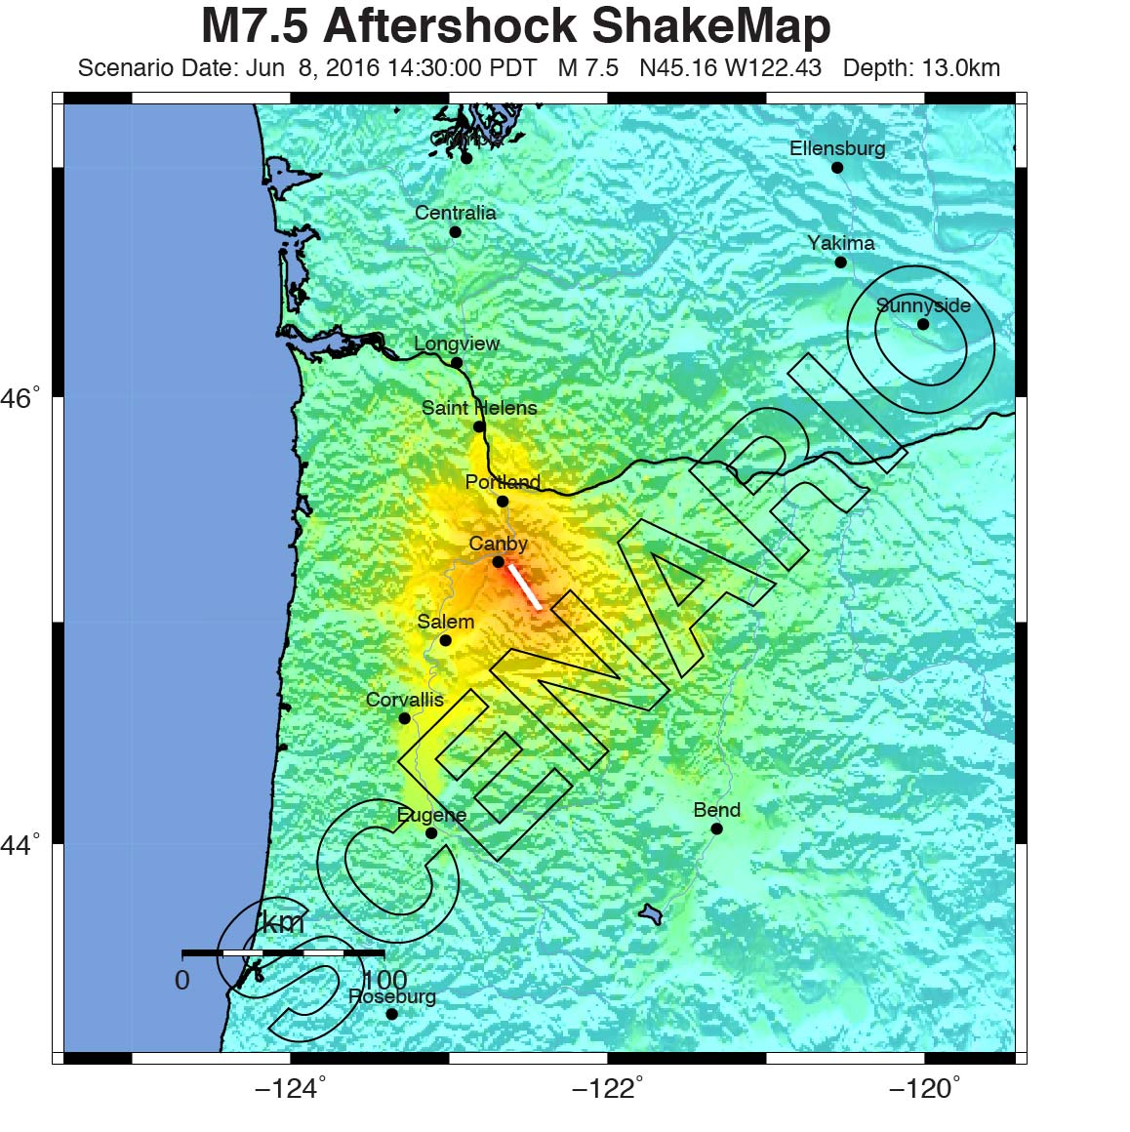
for the mainshock & 7 aftershocks.
Aftershock shaking may be more intense locally than that from the mainshock (e.g. as in Portland for this example).
Notes:
5
Special types of water-saturated sediments lose their strength when shaken, in a process called liquefaction. During shaking pressures may build within buried liquefied sediments causing them to erupt onto the surface, creating features called ‘sand blows’ like those shown in this photo after the 2001 Nisqually Washington earthquake. When sediments liquefy beneath buildings and other structures, severe settling may occur. Photo from the Washington Department of Natural Resources.

Slide 6
PNSN Tweets….

